Slide 1
Humans should seek to control the natural world
Title: Environmental ethics
What do you think?

Slide 2
In pairs, one of you read Genesis 1 and the other read Genesis 2. As you read find quotes that:
Encourage care of the planet
Suggest humans are ‘in charge’
Suggest the land has intrinsic value (intrinsic means it has value by its very nature)
Suggest that land has instrumental value (means that it has value because of what it can be used for/the consequences)
Suggest that human beings are in the image of God
A quote that suggests humans have a different relationship with the Earth than that of the other animals
Notes:
Copies of gen 1 and 2 see word document

Slide 3
Think back to when you learnt about interpreting the Qur’an. Did you read Genesis 1 literally or did you have to interpret the quotes?
How did you find that activity? Was it easy or hard to find quotes?

Slide 4
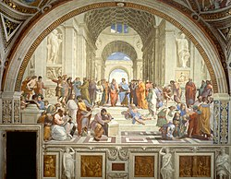
These Genesis texts have been interpreted throughout history in different ways.
We are going to look at four periods of history and how this text has been interpreted.
Historical context
Enlightenment
19th century
Current ecological crisis

Slide 5
1. Historical context
It was written in an ancient, pre-industrial context.
People had no idea how modern science and technology would develop.
They did not know that humans would impact upon the natural world in the ways we do now.
Threats of nature
People at this time were more aware of the threats that nature posed.
Wild animals might cause damage and threaten life.
Adverse weather conditions could drastically affect food supplies.

Slide 6
Historical context
Dominion could be interpreted as not using animals and the environment for whatever humans wish. Instead dominion could refer to humans ruling over domesticated animals and farm animals.
Then God said, "Let us make humankind in our image, according to our likeness; and let them have dominion over the fish of the sea, and over the birds of the air, and over the cattle, and over all the wild animals of the earth, and over every creeping thing that creeps upon the earth." 27 So God created humankind in his image, in the image of God he created them; male and female he created them. 28 God blessed them, and God said to them, "Be fruitful and multiply, and fill the earth and subdue it; and have dominion over the fish of the sea and over the birds of the air and over every living thing that moves upon the earth." (Genesis 1.26-29)
Could be interpreted as instructing people to take possession of the land and to domesticate animals in order to create a peaceful co-existence.

Slide 7
1. Historical context
2. Renaissance/Enlightenment (c.16th century)
Dominion could be interpreted as not using animals and the environment for whatever humans wish. Instead dominion could refer to humans ruling over domesticated animals and farm animals.
Then God said, "Let us make humankind in our image, according to our likeness; and let them have dominion over the fish of the sea, and over the birds of the air, and over the cattle, and over all the wild animals of the earth, and over every creeping thing that creeps upon the earth." 27 So God created humankind in his image, in the image of God he created them; male and female he created them. 28 God blessed them, and God said to them, "Be fruitful and multiply, and fill the earth and subdue it; and have dominion over the fish of the sea and over the birds of the air and over every living thing that moves upon the earth." (Genesis 1.26-29)
Could be interpreted as instructing people to take possession of the land and to domesticate animals in order to create a peaceful co-existence.
3. Industrial revolution (19th century)
4. Age of ecological crisis (20th/21st century)
Using the sheet with the info about the different time periods. Annotate the quotation. How would people in those time periods interpret the words and phrases in the quotation?

Slide 8
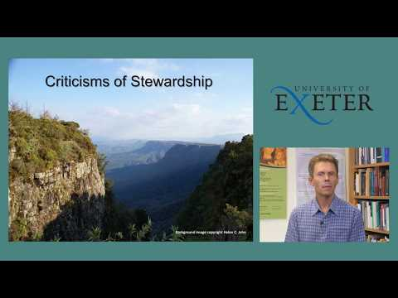
Arguments against stewardship
What are the arguments against stewardship examined in this video?
Writing in the high-profile journal Science in 1967, historian Lynn White proposed that Christian religions undermine wildlife conservation by advocating a domination ethic over nature. Because the Bible talks about "dominion" over nature, White argued that Christianity teaches its followers that "it is God's will that man exploit nature for his proper ends".
Notes:
https://www.youtube.com/watch?v=eoHAyndaUV4&t=3s

Slide 9
Discussion:
Do you think that stewardship is a good or bad way to think about humanity’s relationship to the world?
Theological question: What model of relationships between God, humanity and the non-human creation does 'stewardship' imply?
Notes:
The other questions in the bubbles are optional.

Slide 10
Homework – using the information about different Christian denomination’s attitude towards the environment to complete the sheet.

Slide 11
1. Historical context
2. Renaissance/Enlightenment (c.16th century)
Then God said, "Let us make humankind in our image, according to our likeness; and let them have dominion over the fish of the sea, and over the birds of the air, and over the cattle, and over all the wild animals of the earth, and over every creeping thing that creeps upon the earth." 27 So God created humankind in his image, in the image of God he created them; male and female he created them. 28 God blessed them, and God said to them, "Be fruitful and multiply, and fill the earth and subdue it; and have dominion over the fish of the sea and over the birds of the air and over every living thing that moves upon the earth." (Genesis 1.26-29)
3. Industrial revolution (19th century)
4. Age of ecological crisis (20th/21st century)
Notes:
A4 or A3

Slide 12
Find a quote that | Genesis 1 | Genesis 2
Encourages care of the planet
Suggests humans are ‘in charge’
Suggests the land has intrinsic value
Suggests that land has instrumental value
Suggests that human beings are made in the image of God
A quote that suggests humans have a different relationship with the Earth than that of other animals
Notes:
A4 1 each

